Slide 1


CSE44D
OBJECT ORIENTED PROGRAMMING USING C++
Lecture #0
Let’s explore and move
to “Better C”

Slide 2
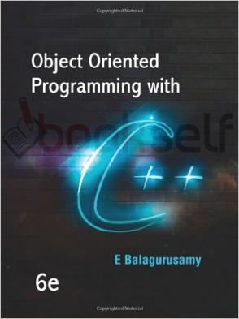
Course details
LTP – 3 0 0
Text Book
  OBJECT ORIENTED PROGRAMMING IN C++
  by E BALAGURUSAMY, MCGRAW HILL
  EDUCATION

Slide 3
Course Assessment Model
Marks break up*
Attendance 5
CA (Two best out of Three) 25
MTE 20
ETE 50
Total 100

Slide 4

Acknowledgements
MIT OpenCourseware
Stanford online
Udemy
Coursera
The homepage of Bjarne Stroustrup, the inventor of C++:
http://www.research.att.com/~bs
A C++ online tutorial:
http://www.cplusplus.com/doc/tutorial/
The C++ FAQ:
http://www.parashift.com/c++-faq-lite
learncpp.com
and many, many more!

Slide 5
The course contents
Unit I: Concepts and basics of object oriented programming
Unit II: Working with arrays, functions, and Structures
Unit III: Working with classes and objects

Slide 6
Unit IV: Inheritance in C++ .
Unit V : Polymorphism and its various types
Unit VI: File handling in C++

Slide 7

The hitch…
The BURNING questions in mind…
Oh no… Why another Programming Language ?
What would we do with it, we already know C?
Will it really help improve my programming skills?

Slide 8
A Better C
C++
  Improves on many of C's features
  Has object-oriented capabilities
    Increases software quality and reusability
  Developed by Bjarne Stroustrup at Bell Labs
    Called "C with classes“ an enhanced version of C
  Superset of C
    Can use a C++ compiler to compile C programs
    Gradually evolve the C programs to C++
Towards better programming….

Slide 9
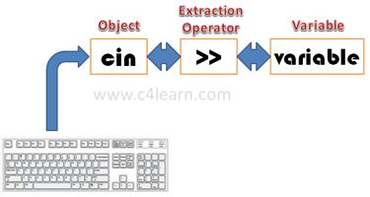
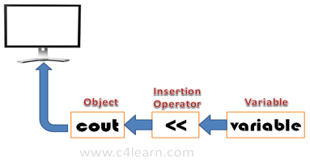
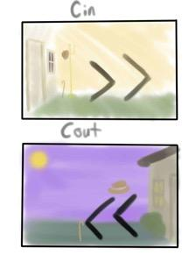
Concepts and Basics of C++ Programming
Bring in through cin and Take out through cout

Slide 10
Object ,Object and Object
A student, a professor
A desk, a chair, a classroom, a building
A university, a city, a country
A subjects such as Physics, Math, History, …

Slide 11

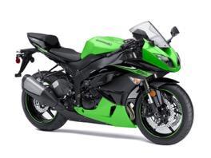

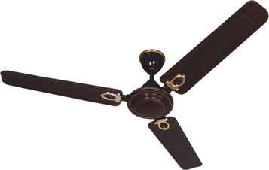

Daily Analysis
Look around you and identify some objects
Everything is an OBJECT

Slide 12
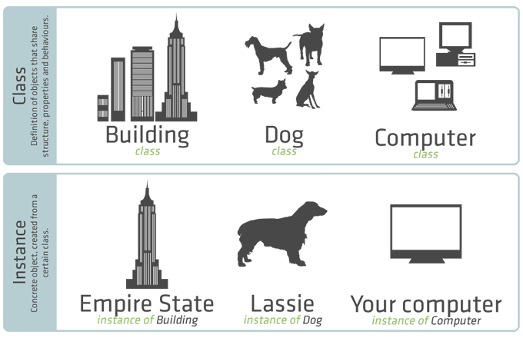
CLASSES v/s OBJECTS

Slide 13
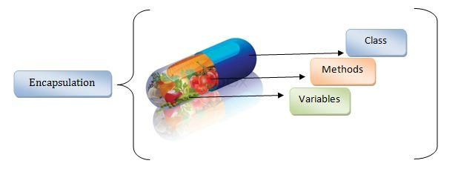
Encapsulation

Slide 14
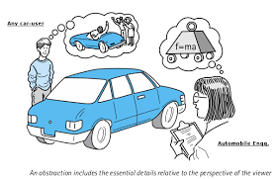
DATA ABSTRACTION

Slide 15
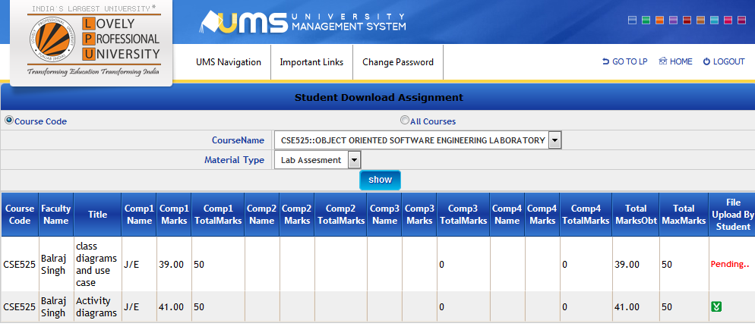
Hiding data
Update Marks

Slide 16
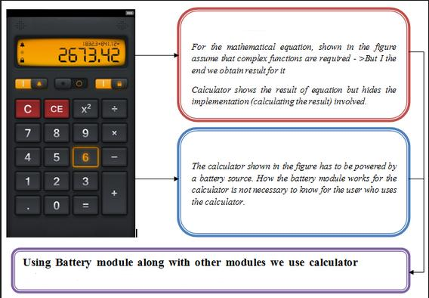
Hiding Details

Slide 17

Message Passing

Slide 18
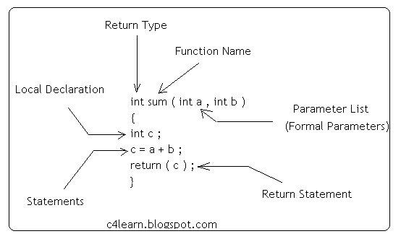
Function

Slide 19
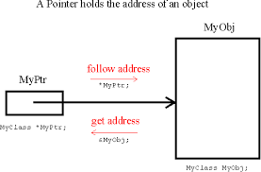
Pointers

Slide 20
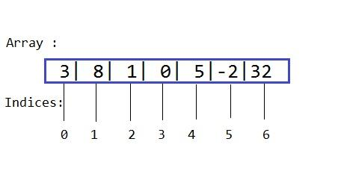
Array

Slide 21
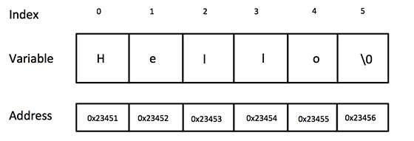
String

Slide 22
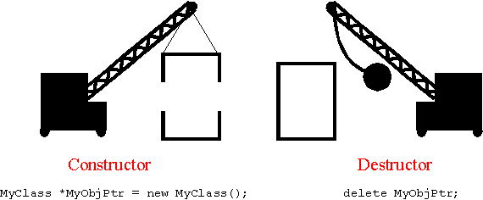
Constructors, Destructors

Slide 23
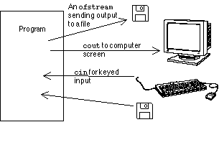
File Handling in C++

Slide 24
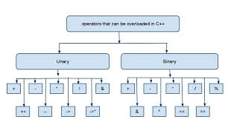
Operator Overloading

Slide 25
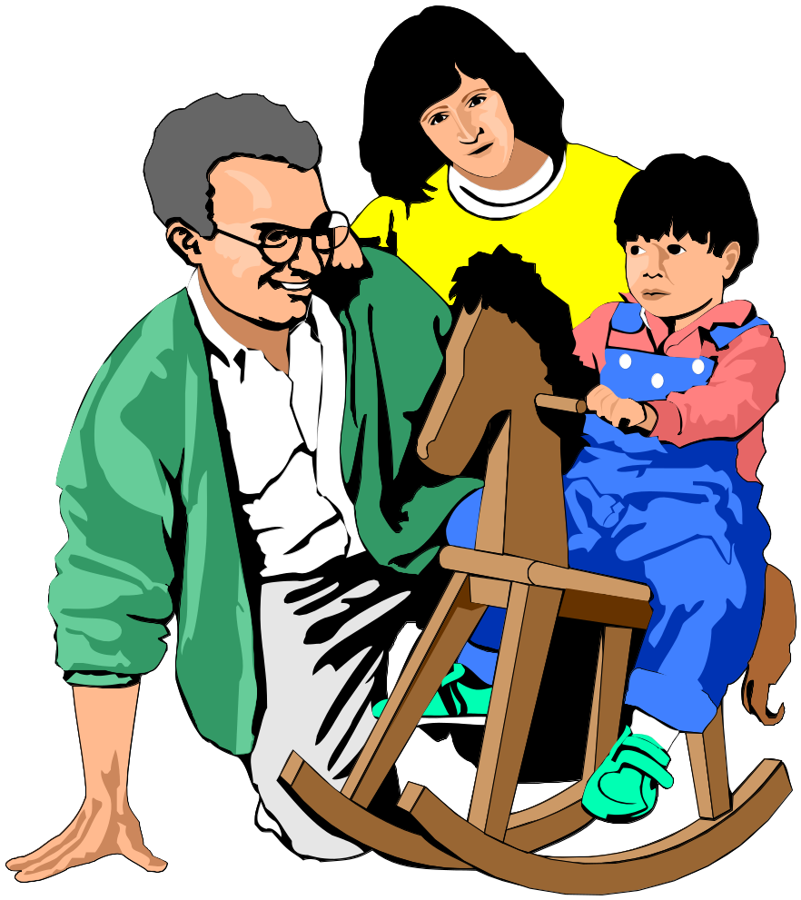
Traits Passed Through Inheritance
But Mummy, where did my blue eyes come from?

Slide 26

Student and Graduate Student

Slide 27
So what does this mean?
Student
Graduate Student
The Student Inherited and built upon the learning from past

Slide 28
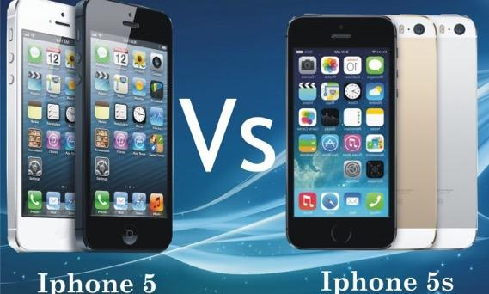
Reuse, Reduce & Reliable !!!
Existing Features
Existing Features + Additional Features

Slide 29
Dynamic Memory Management
C++ uses new and delete operator for dynamic memory management.

Slide 30
Data abstraction refers to providing only essential information about the data to the outside world, hiding the background details or implementation.
INHERITANCE: it is the process by which object of one class acquire the properties or features of objects of another class. The concept of inheritance provide the idea of reusability means we can add additional features to an existing class without Modifying it. This is possible by driving a new class from the existing one. The new class will have the combined features of both the classes.

Slide 31
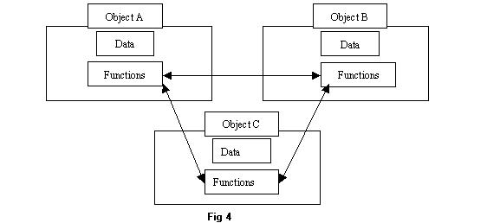
MESSAGE PASSING: The process by which one object can interact with other object is called message passing.
DYNAMIC BINDING: Refers to linking of function call with function definition is called binding and when it is take place at run time called dynamic binding.
POLYMORPHISM: A Greek term means ability to take more than one form. An operation may exhibit different behaviours in different instances. The behaviour depends upon the types of data used in the operation.
Example:
Operator Overloading
Function Overloading

Slide 32
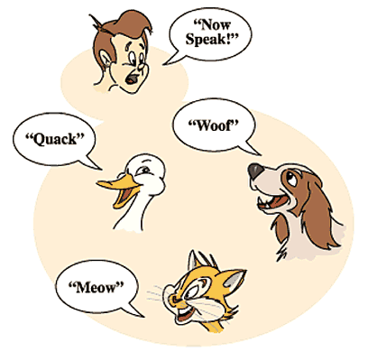
Polymorphism

Slide 33



Expression of a student
In front of father
In class
In CCD
One thing and many forms

Slide 34
Procedure Oriented Programming
A program in a procedural language is a list of instruction where each statement tells the computer to do something. It focuses on procedure (function) & algorithm is needed to perform the derived computation.
When program become larger, it is divided into function & each function has clearly defined purpose. Dividing the program into functions & module is one of the cornerstones of structured programming.
E.g.:- c, basic, FORTRAN.

Slide 35
Object-Oriented Programming
The main idea behind object oriented approach is to combine process (function) and data into a unit called an object. Hence, it focuses on objects rather than procedure.
Characteristics of Object Oriented Programming :
Objects:-
  Any physical or logical units having specific characteristics which match to the real world are called as object.
  Object oriented approach views a problem in terms of objects rather than procedure.

Slide 36
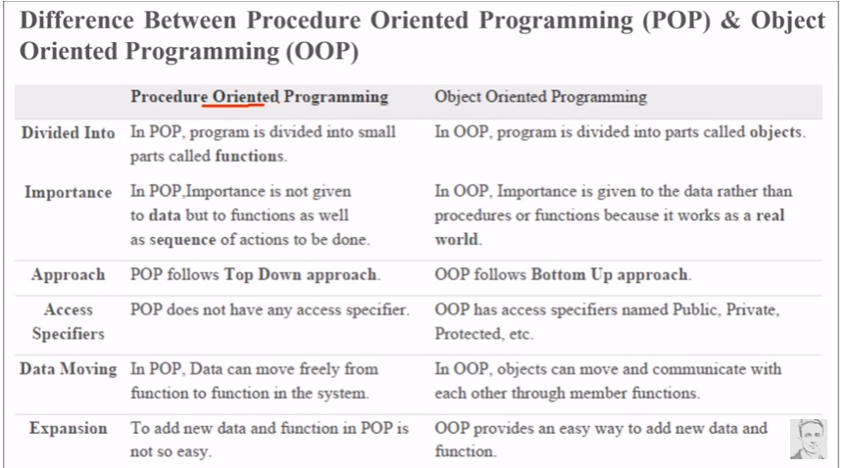

Slide 37
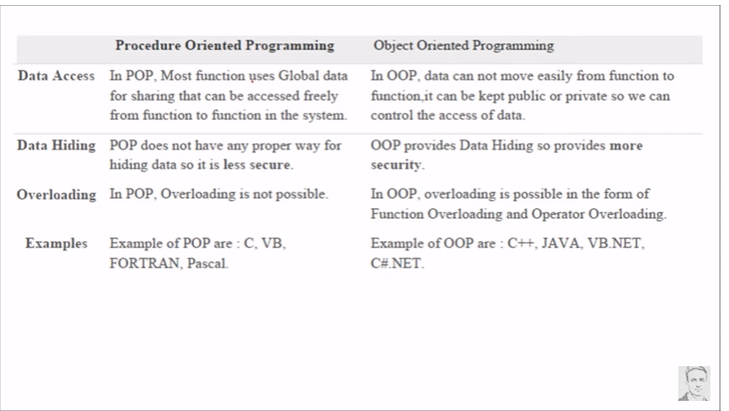

Slide 38
POP v/s OOP
In POP, program is divided into small parts called functions. | In OOP, program is divided into parts called objects.
In POP, Importance is not given to data but to functions | In OOP, Importance is given to the data rather than procedures or functions because it works as a real world.
POP follows Top Down approach. | OOP follows Bottom Up approach.
POP does not have any access specifier. | OOP has access specifiers named Public, Private, Protected, etc.
In POP, Data can move freely from function to function in the system. | In OOP, objects can move and communicate with each other through member functions.
In POP, Most function uses Global data for sharing that can be accessed freely from function to function in the system. | In OOP, data can not move easily from function to function,it can be kept public or private so we can control the access of data.
POP does not have any proper way for hiding data so it is less secure. | OOP provides Data Hiding so provides more security.
In POP, Overloading is not possible. | In OOP, overloading is possible in the form of Function Overloading and Operator Overloading.
Example of POP are : C, VB, FORTRAN, Pascal. | Example of OOP are : C++, JAVA, VB.NET, C#.NET.

